Slide 1




Autonomous 3D Mapping for Virtual-Reality Applications
Shreya Udupa
NASA Space Grant 2017 Symposium

Slide 2
Objective
Can we develop a robotic platform to generate comprehensive 3D maps of an indoor space?
Applications:
Extreme environment mapping
Disaster area mapping
VR gaming mapping

Slide 3
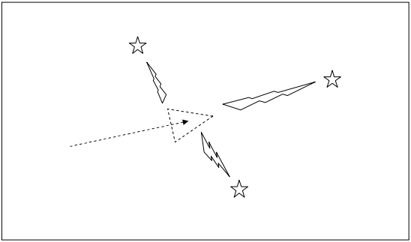
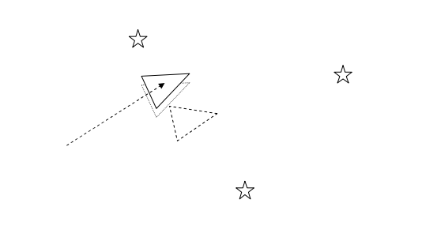
Background: SLAM
SLAM refers to the unique problem of Simultaneous Localization and Mapping

Slide 4
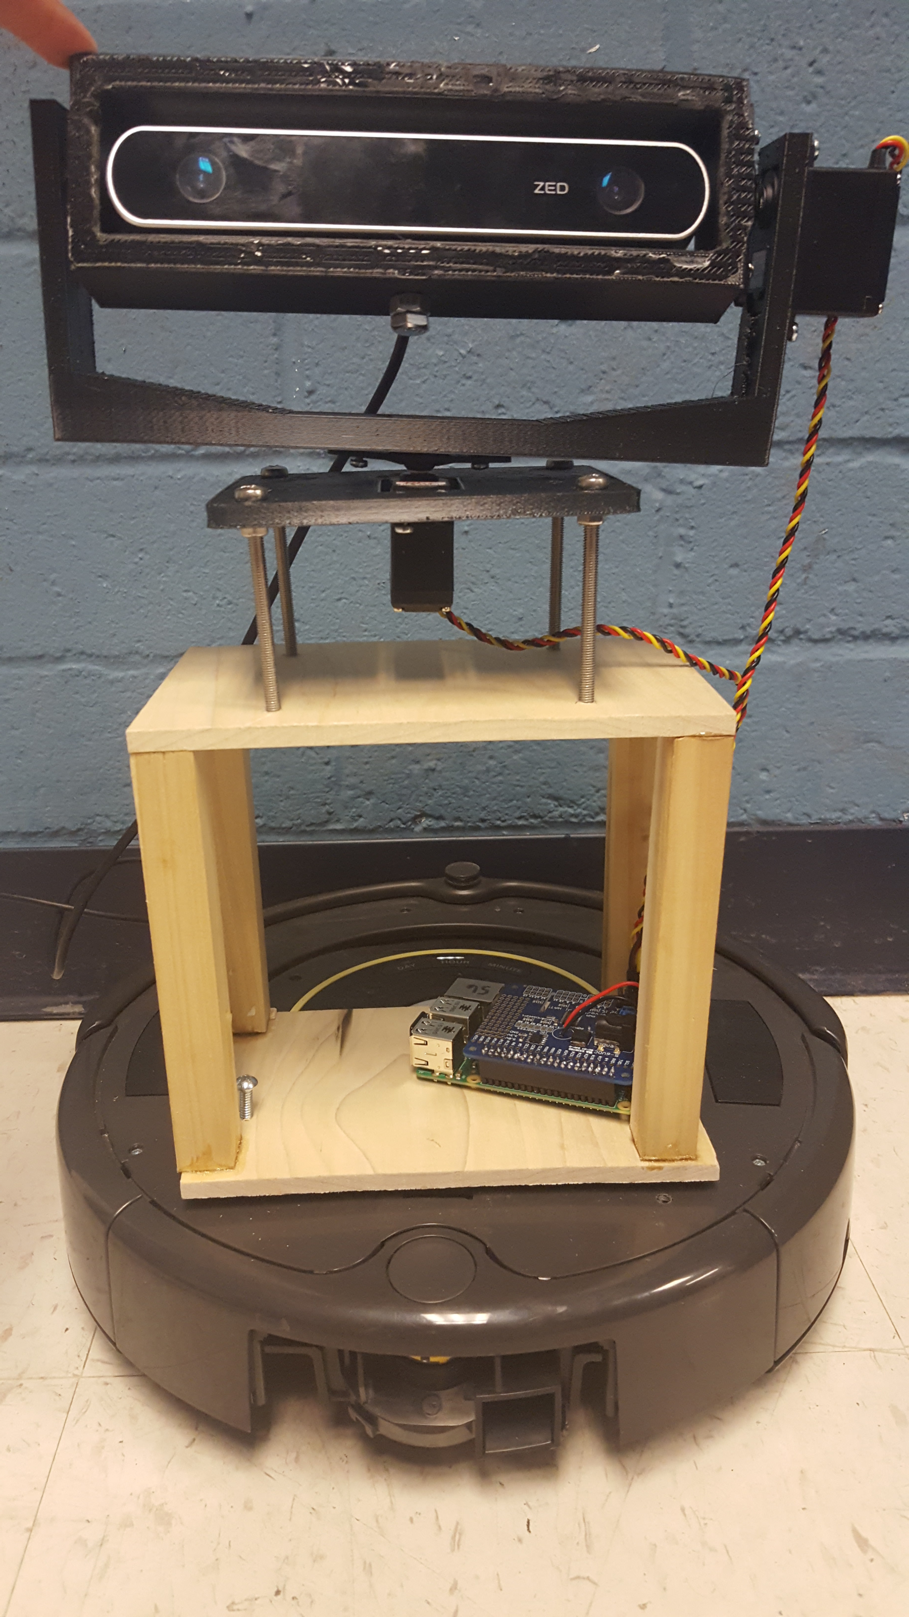
Robotic Platform
Depth Camera
Servo Motors
Microcontroller
Roomba

Slide 5
Map Building: RTAB-MAP
Software for compiling point clouds from a depth camera
Runs on ROS (Robotic Operating Software)
Close-loop detection
Can run on any operating system including Raspberry-Pi

Slide 6
Autonomous Exploration
Robotic implementation of RTAB-MAP
Addendum to initial objective: Can the robot autonomously explore its environment and build a better map?
Mesh-vacancy localization

Slide 7
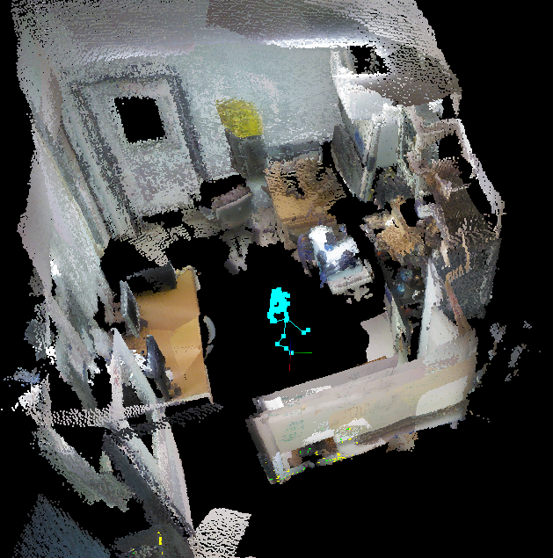
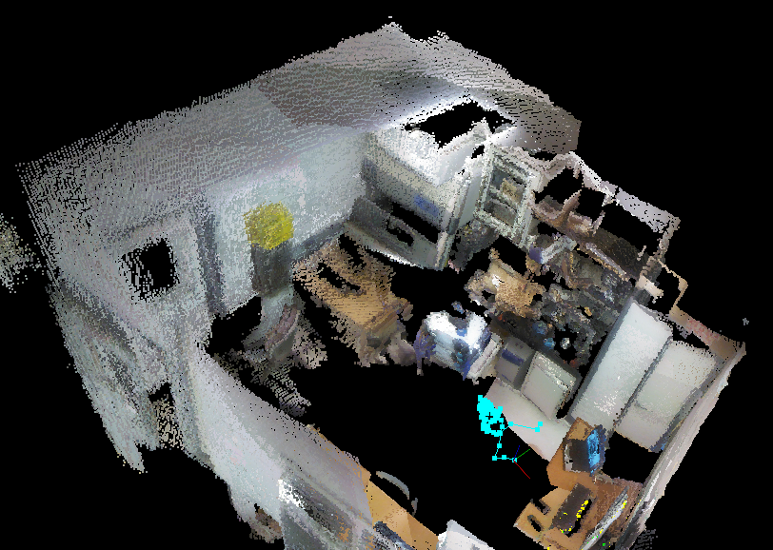
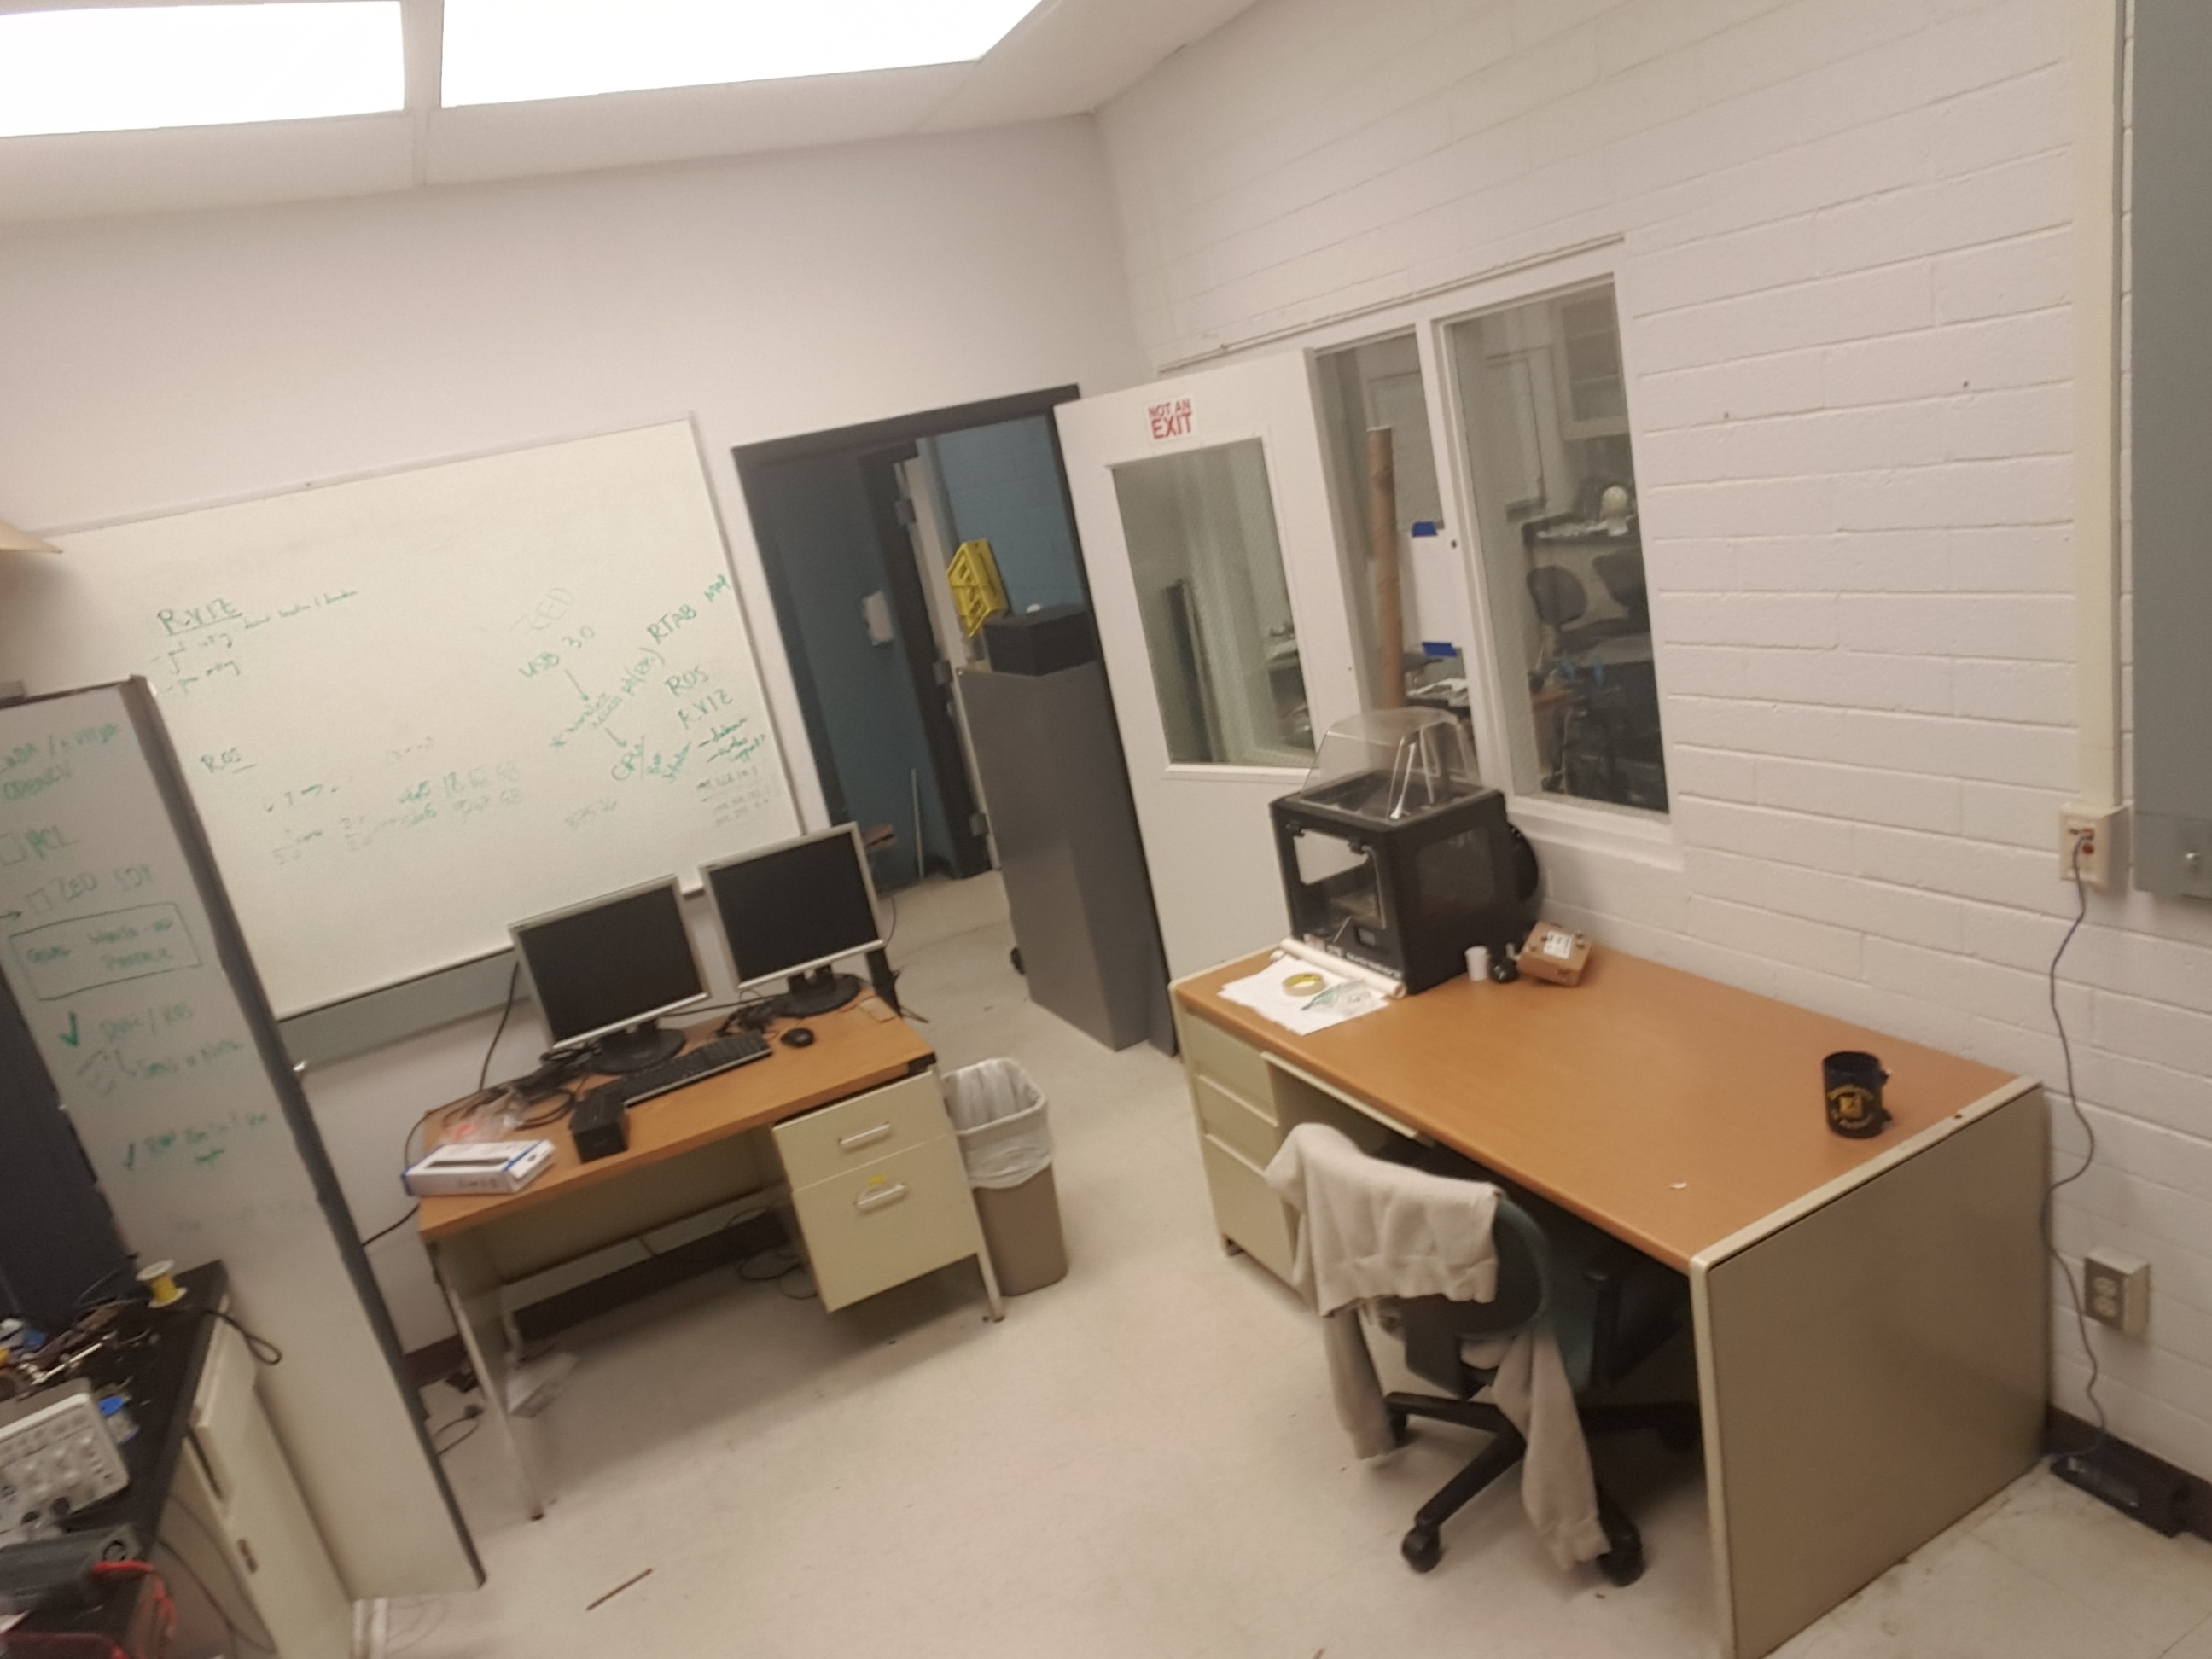
Resulting Maps
Implemented on Oculus Rift

Slide 8
Acknowledgements
I would like to thank Dr. Artemiadis and all my friends at the HORC lab for their help in developing this technology!
Special thanks to Ryian Hunter, Varun Nalam, Bryan Whitsell, Tyler McDaniel, George Karavas, and Chuong Nguyen

Slide 9
Questions?

